Slide 1
PRESENTED BY:
BHAVATHARANI S
B.Tech-INFORMATION TECHNOLOGY(3RD YEAR)
UNIVERSITY COLLEGE OF ENGINEERING,VILLUPURAM.
REGISTER NO:422521205008
MAIL ID:bhavatharanibhavatharavi136@gmail.com

Slide 2
PROJECT TITLE
A DEEP LEARNING APPROACH TO HEALTH CARE CHATBOT

Slide 3
AGENDA
PROBLEM STATEMENT
PROJECT OVERVIEW
WHO ARE THE END USERS
OUR SOLUTIONS AND ITS VALUES PROPOSITION
THE WOW IN OUR SOLUTION
MODELLING
RESULTS
CONCLUSION

Slide 4
PROBLEM STATEMENT
Deep learning offers a promising solution by enabling the development of a healthcare chatbot that can:
Provide 24/7 access to reliable health information in a user-friendly format.
Conduct symptom analysis to suggest potential causes and encourage users to seek professional help when necessary.
Offer initial guidance on self-care and preventative measures.
Break down language barriers by offering multilingual support.
Anonymously address sensitive health concerns, potentially encouraging earlier intervention.

Slide 5
PROJECT OVERVIEW
Develop a chatbot that understands natural language queries related to health concerns.
Utilize deep learning models to analyze user-provided
symptoms and suggest potential causes (for informational purposes only).
Offer reliable health information and resources based on user inquiries.
Provide a user-friendly and accessible interface for interaction.
Technical Approach:
Natural Language Processing (NLP):
Train a deep learning model (e.g., RNNs) on a massive medical text dataset to
understand user intent and extract relevant information from their queries.

Slide 6
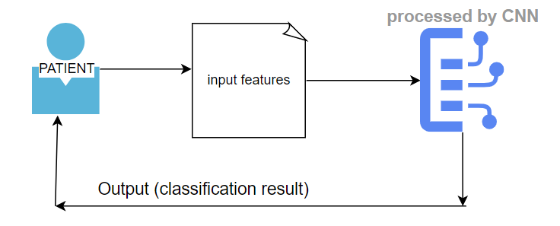
Symptom Analysis and Disease Prediction:
Train a separate deep learning model on labeled datasets linking symptoms to diseases.
This model will analyze user-reported symptoms and suggest potential causes, emphasizing
the need for professional consultation for any serious concerns.
Data Security and Privacy:
Ensure responsible data collection practices with proper user consent and anonymization of training data.
Implement robust security measures to safeguard sensitive health information.

Slide 7
WHO ARE THE END USER
Individual Patients:
General Public : This includes anyone seeking information about general health topics, preventative Measures, or self-care practices
People in Remote Areas: Individuals with limited access to healthcare professionals can benefit from 24/7 access to reliable health information and initial guidance.
2. Healthcare Providers and Institutions:
Doctors and Nurses: The chatbot can be used to triage patients, answer basic questions, and free up healthcare professionals' time for more complex cases.
Hospitals and Clinics: Chatbots can be integrated into their systems to offer patients 24/7 support, improve appointment scheduling, and enhance overall patient experience.
Public Health Organizations: Chatbots can be used for disseminating public health information, General Public: This includes anyone seeking information about general health topics, preventative measures, or self-care practices.

Slide 8
OUR SOLIUTION AND ITS PROPOSITION
We propose a healthcare chatbot built on a robust deep learning foundation, designed to empower individuals to take charge of their health and bridge the gap to quality healthcare information.
Unique Propositions:
Enhanced Accessibility: 24/7 availability ensures information is at your fingertips whenever you need it.
AI-powered Symptom Analysis: Leverage deep learning to analyze user-reported symptoms and suggest potential causes (for informational purposes only), encouraging users to seek professional help when necessary.
Multilingual Support: Break down language barriers and empower a wider audience to access healthcare information in their preferred language.
Personalized Health Assistant: The chatbot tailors responses based on user queries and sentiment, fostering a more engaging and supportive interaction.
Focus on User Privacy: We prioritize responsible data collection with user consent and anonymization, ensuring your health information remains secure.

Slide 9
Benefits for End Users:
Individuals: Gain access to reliable health information, receive initial guidance on self-care, and be empowered to make informed decisions about their health.
Healthcare Providers: Free up valuable time for complex cases by utilizing the chatbot for basic consultations and patient support.
Public Health Organizations: Effectively disseminate public health information and promote preventative healthcare initiatives.
Competitive Advantage:
Our deep learning approach goes beyond basic symptom checkers. We prioritize user privacy, offer multilingual support, and continuously refine the chatbot's capabilities through user feedback and data analysis.
Call to Action:
Let's revolutionize access to healthcare information. We invite you to partner with us in creating a future where everyone has the tools and knowledge to take charge of their well-being.

Slide 10
THE “WOW” IN OUR SOLUTION
Cutting-edge AI for Advanced Symptom Analysis
Personalized Health Insights and Recommendations
Seamless Integration with Wearables and Health Data Platforms
AI-powered Emotional Intelligence and Support
User friendly

Slide 11
MODELLING
1. Natural Language Processing (NLP) Model:
This is the foundation for understanding user queries.
Model Type: Utilize a Recurrent Neural Network (RNN) like Long Short-Term Memory (LSTM) or Gated Recurrent Unit (GRU) for their ability to handle sequential data like sentences.
Training Data: Train the model on a massive dataset of medical text data, including medical journals, patient records (anonymized), and healthcare information websites. This data should be labeled with relevant information like user intent (what the user wants) and entities (specific details like symptoms).
2. Symptom Analysis and Disease Prediction Model:
This model analyzes user-reported symptoms and suggests potential causes. Important Disclaimer: Emphasize that this is for informational purposes only and should not be used for self-diagnosis.
Model Type: Explore Convolutional Neural Networks (CNNs) for identifying patterns in symptom descriptions or explore transformers, a powerful architecture for understanding complex relationships in text data.
Training Data: Train the model on a labeled dataset linking symptoms to diseases. This data can be obtained from medical coding databases or by collaborating with medical professionals.

Slide 12
3. Conversational Flow and User Experience Model:
This model personalizes the chatbot's responses and improves the overall user experience.
Model Type: Utilize a Reinforcement Learning (RL) model. The chatbot interacts with users and receives rewards for informative, empathetic, and engaging responses. This feedback loop allows the model to learn and improve conversation flow over time.
Training Data: Train the model on simulated conversations or past user interactions (anonymized) to learn effective communication strategies.
Additional Considerations:
Multilingual Support: Integrate machine translation models to enable the chatbot to understand and respond in multiple languages.
Data Security and Privacy: Ensure user consent for data collection and implement robust anonymization techniques.
Explainability and Transparency: Develop mechanisms to explain the chatbot's reasoning behind symptom analysis suggestions, fostering user trust.

Slide 13
Overall Architecture:
The NLP model processes user queries, extracts relevant information, and identifies the user's intent.
Based on the intent, the system might direct the conversation to the symptom analysis model or directly provide informative responses from a knowledge base.
The symptom analysis model analyzes user-reported symptoms and suggests potential causes.
The conversational flow model personalizes responses and guides the conversation to ensure a clear and engaging user experience.
Remember:
Continuously improve your models by incorporating user feedback and retraining with new data.
Partner with medical professionals to ensure the accuracy and credibility of the chatbot's responses.
By implementing these models effectively, you can create a deep learning healthcare chatbot that empowers individuals to manage their well-being and bridge the gap to quality healthcare information.

Slide 14
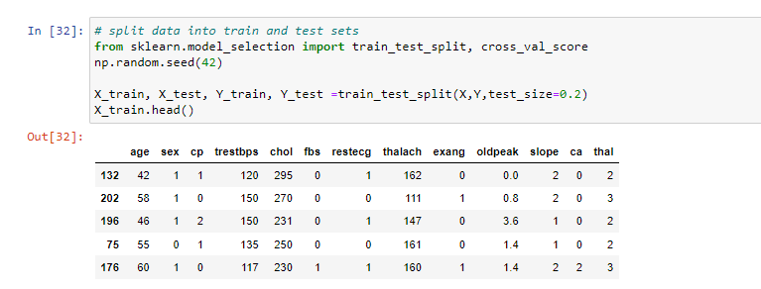
RESULT
Unleash the power of AI for your health! Our chatbot analyzes your symptoms (for informational purposes only) and offers personalized insights. Ask questions, get reliable info, and feel empowered to manage your well-being.

Slide 15
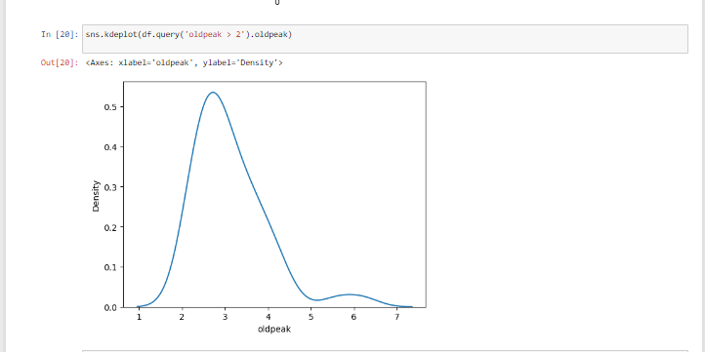
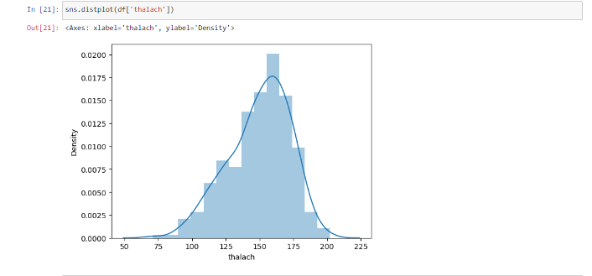

Slide 16
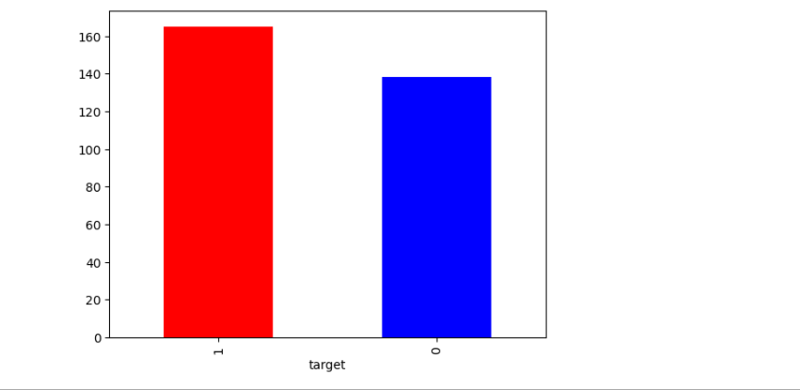
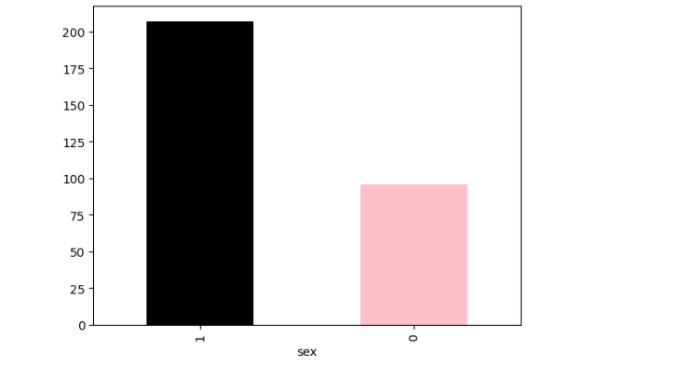
MODEL PERFORMANCE VISUALIZATION: Each bar represents the accuracy (or chosen metric) of a specific model. Use different colors to distinguish the bars for better visibility.

Slide 17
CONCLUSION
The future of healthcare is here! This deep learning-powered healthcare chatbot empowers you to take charge of your well-being. It analyzes your symptoms (for informational purposes only) and provides personalized insights, along with reliable health information. Ask questions, feel informed, and be proactive about your health.

Slide 18
THANK YOU

